Slide 1
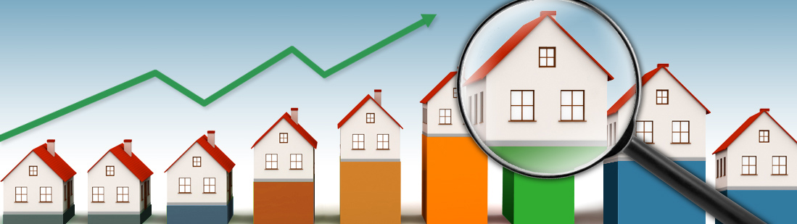
Housing Market: Ames Iowa
Wiafe Busia
Daphne Mixon – Tinsley
Melat Yohannes

Slide 2
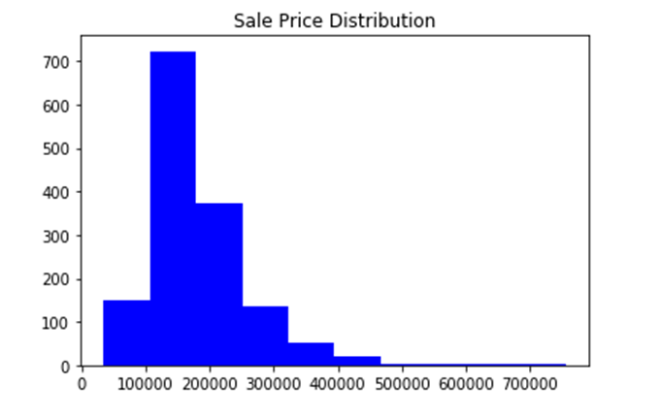
What is the average home sale price in Ames, Iowa?
The average home price is $180,921.
The maximum sales price for our sample size of 1460 purchases was $755,000 and the minimum was $34,900.

Slide 3
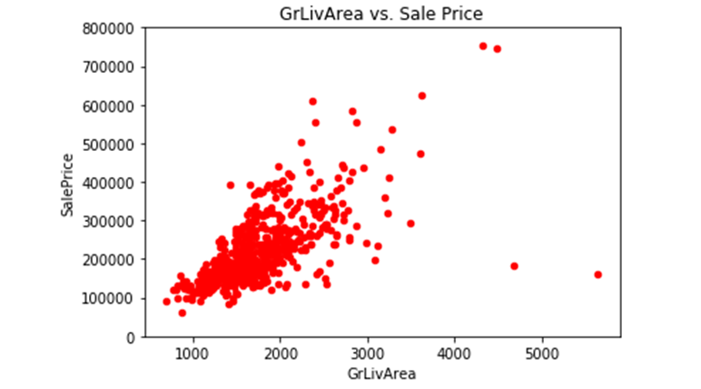
Is there a correlation between total square footage and the sale price of a home?
Yes, there is a direct correlation between square footage and selling price of a home. As the size of the house increases so does the sale price.
*Our data shows a couple of outliers which could be due property condition.

Slide 4
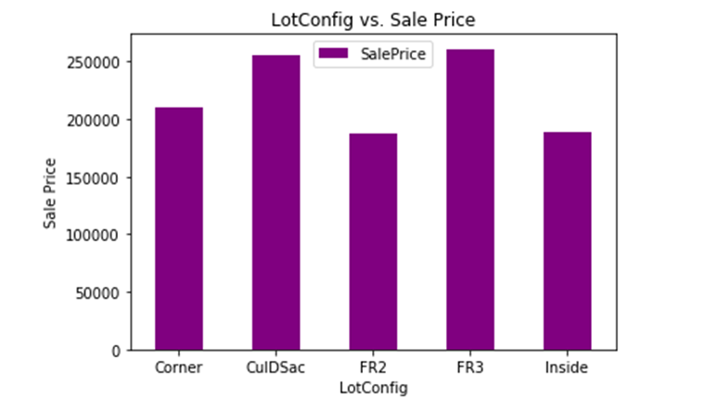
Does the location of the lot the house is situated on impact price?
Yes, the data shows homes that sit on a Cul-de-sac demand have a higher sale price than homes on inside lots.

Slide 5
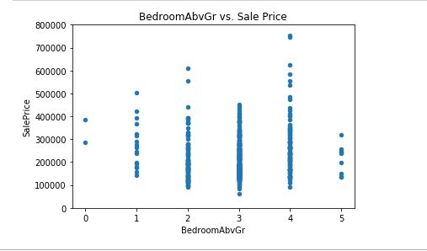
How does the number of bedrooms impact the sale price?
As the number of bedrooms increased so did the relative sales price.
The most popular size home was four bedrooms. The sale price declined moderately for a home with five bedrooms.

Slide 6
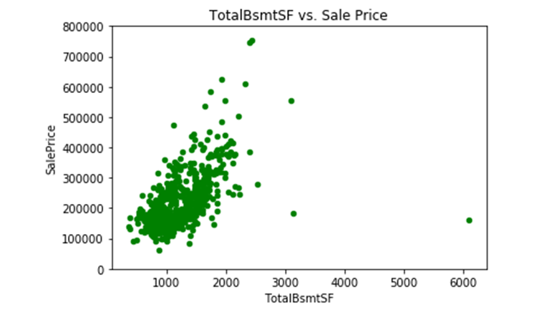
Is there a correlation between a house having a basement and the sale price?
Yes, if the home has a basement the price is positively impacted due to the increase in square footage.
The larger basement higher the price because the total livable space increases.

Slide 7
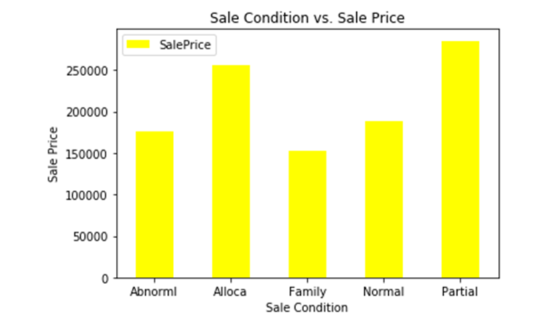
Does the type of sale or sale condition impact sale price?
The sale condition (type of sale) impacts price. Partial property sales account for the largest number of sales in our target market. A partial sale is one where large parcels of (farm) land are split for sale or a house is sold with a small portion of the land parcel.

Slide 8
Questions?

